Slide 1
Uncertainty and Error Propagation

Slide 2
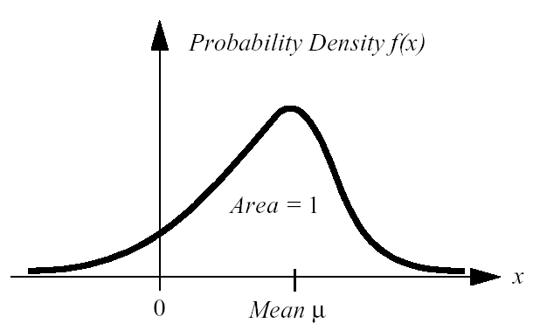



Uncertainty Representation (2)

Slide 3
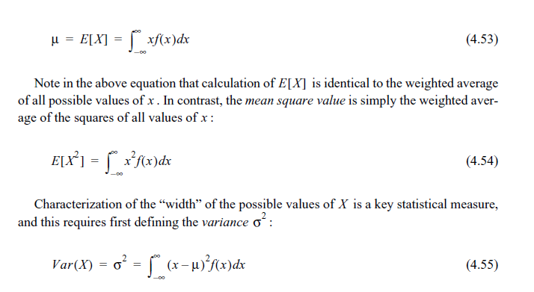

Slide 4
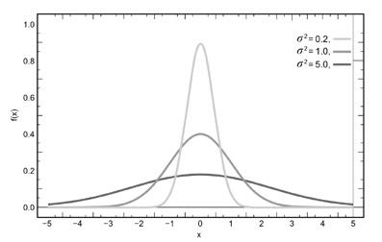
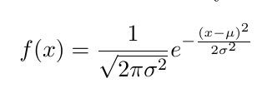
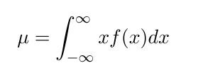
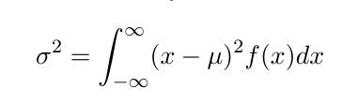
The Gaussian (“Normal”) Distribution

Slide 5

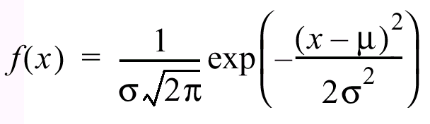
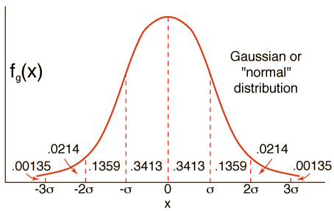
Gaussian Distribution
0.4
68.26%
95.44%
99.72%
-2
-1
1
2

Slide 6
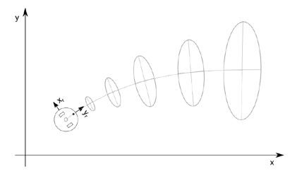
2D Gaussian Distribution
How does uncertainty propagate?

Slide 7
Error Propagation Law
Sometimes random variates are combinations of others
Example: x, y and theta result from wheel slip (two random variates)
If the PDFs are Gaussian, their variances add up
Intuition: weigh each component with their variance

Slide 8



Error propagation
Random variable Y is a function of random variable X
New variance
Weighed by the gradient with respect to X
Measure of how important a change in X is to Y
Multi-input, Multi-output leads to covariance matrices

Slide 9
The Error Propagation Law
Error propagation in a multiple-input multi-output system with n inputs and m outputs.
X
Y
1
1
…
…
X
System
Y
i
i
…
…
X
Y
n
m

Slide 10

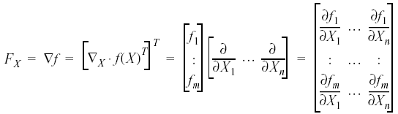
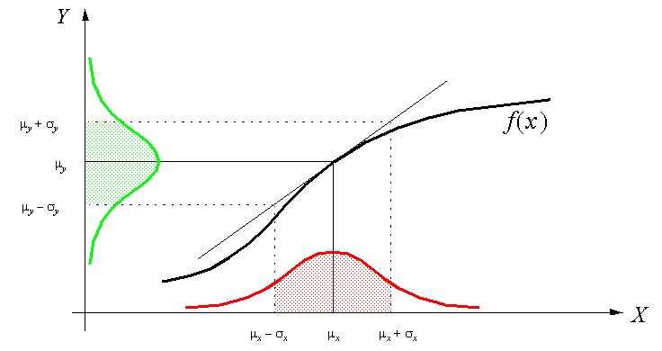
The Error Propagation Law
One-dimensional case of a nonlinear error propagation problem
It can be shown that the output covariance matrix C_{Y} is given by the error propagation law:
where
C_{X}: covariance matrix representing the input uncertainties
C_{Y}: covariance matrix representing the propagated uncertainties for the outputs.
F_{X}: is the Jacobian matrix defined as:
which is the transposed of the gradient of f(x)

Slide 11
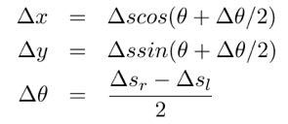


Example: Odometry
Forward Kinematics
(maps wheel slip to pose)
Error update
Component from Motion
Additional wheel - slip
Propagation from position p to new position p’

Slide 12
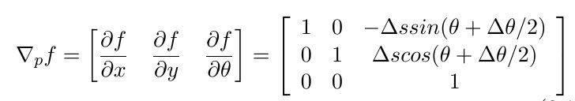
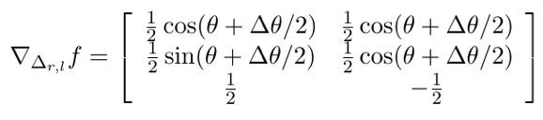



Example: Odometry
Partial derivatives of kinematics with respect to pose
Partial derivates of kinematics with respect to wheel-slip
Partial derivatives of of f with respect and (3x2) matrix
Wheel slip covariance matrix

Slide 13
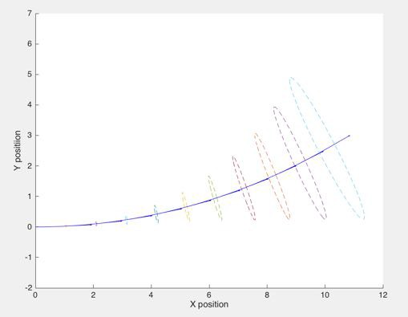
Demo: Odometry error

Slide 14
Summary
Most variables describing a robot’s state are
random variables
Variates of a random variable are drawn from
Probability Density Functions (PDF)
A common, because convenient, PDF is the Gaussian Distribution deﬁned by its mean and variance
For Gaussians, variances add up and are weighed by the impact they have on the combined random variable (“Error Propagation Law”)

